Slide 1
Workshop Day#1
Project Design Cycle

Slide 2
Project Design Cycle
1) Situation Analysis
2)Organizational Capacity Assessment
3) Project Design and Planning Framework
4) Project Monitoring and Evaluation Plan
5) Project Budget
6) Project Implementation and Monitoring
7) Final Evaluation and Dissemination of Lessons Learned

Slide 3
Program Sustainability
Sustainability refers to the ability of the program to provide a lasting and permanent service by ensuring the continuity and high quality of work with young people and local communities.

Slide 4
Project Success Factors
Proper Planning
Responding to Needs of Beneficiary Group
Involvement of Key Stakeholders
Gender Equality
Project Team Efficiency
Adhering to Donor Guidelines
Organizational Capacity
Clearly Identify Beneficiaries and Targets

Slide 5
Dual Client Assessment
  Aim: To analyze the labor market, to assess the needs of young people and employers, to bridge the needs of the labor market with the skills required by young people, and to ensure that young people are able to reach these opportunities.

Slide 6
Executive Summary Questions
Do the results meet your expectations? Why?
Were there any unexpected results? Why?
Which results do you find most interesting?
What challenges do you think you and your project will face?
How would having this LMA help you to design your project?
What key pieces of information will you use to inform your project design? How?

Slide 7
Problem Statement
Which causes are the most responsible for the problem?
Which cause, if reduced or eliminated, will contribute to reducing the overall problem to the highest degree?
Which causes does the organization have the capacity to address based on results of an organizational assessment such as analysis of strengths, weaknesses, opportunities and threats (SWOT)?
Which causes have not been addressed by any other organization or have been addressed to a limited degree?

Slide 8
SMART Objectives
Specific
Measurable
Achievable
Relevant
Time-bound

Slide 9
What are SMART Objectives?
  SPECIFIC: What exactly is the project going to do, where, with or for whom?
  MEASURABLE: Are the stated results measurable? Does the organization have the capacity to measure them?
  ACHIEVABLE: Can we get it done in the timeframe? In this political climate? With this amount of money and resources?
  RELEVANT: Is the objective/outcome important to achieving the desired result? Is it in line with the organizational strategy?
  TIME-BOUND: When will this objective/outcome be accomplished?

Slide 10
WHAT IS MEL?
Monitoring:
Routine tracking and reporting of priority information about a project or program: its inputs, activities, outputs, outcomes and impacts.
Evaluation
Systematic and objective assessment of an on-going or completed project, program, or policy, and its design, implementation and results.
Learning
Use of data and insights from a variety of information-gathering approaches – including monitoring and evaluation — to inform strategy and decision making.

Slide 11

Example Indicators
Number of participants
Number of people who completed the course
Proportion of women
Number of volunteer projects
Number of employment after XX months
Notes:
Ölçülmeli ve belirli olmalı

Slide 12
Workshop Day#2
Partnership and Stakeholder Engagement

Slide 13
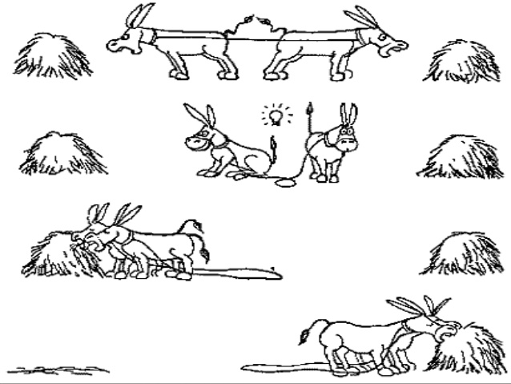
Win-Win Interpretation

Slide 14

Partnership Continuum
Reproduced from: John Snow, Inc. (JSI). 2012. “Implementing and Maintaining Partnerships,” Engaging Your Community. A Toolkit for Partnership, Collaboration, and Action.

Slide 15
Four Basic Elements for Successful Partnerships
1) Shared purpose
2) Flexibility and willingness to collaborate
3) Complementary strengths
4) Agreed upon boundaries

Slide 16
Defining Strategic Partnerships
A partnership is strategic when it provides your organization with the means and methods for advancing your mission. Strategic partnerships can later develop into stakeholder groups that can leverage greater influence in reaching elected officials and policymakers. Civic leaders, policymakers and other key influencers tend to have priorities that organizations can leverage to underscore the urgency of improving programs and services to adolescents including:
Improving access to education to foster economic development and work skills;
Enhancing public safety by preventing crime and reducing risk behaviors; and
Encouraging civic engagement and service to a new generation.
Reproduced from: John Snow, Inc. (JSI). 2012. “Implementing and Maintaining Partnerships,” Engaging Your Community. A Toolkit for Partnership, Collaboration, and Action.

Slide 17
Benefits of the Partnership with the Public Sector
New opportunities for programs such as youth clubs at public schools
Expanding the scope of work of programs increases the impact
Facilitates the implementation process by providing legal legitimacy to the activities
Notes:
Add another slide about advantages in working with private sector
Financial contributions
In- Kind: machines, supplies, etc
Marketing/PR
Introduction to other partners
Mentorship/Internships
Final Jobs

Slide 18
Benefits of the Partnership with the Private Sector
Provides cash and in kind support. (Equipment, materials, training guide, practice)
Provides the opportunity to benefit from information and partnership network (New partnership opportunities)
Offers access to media and marketing access and coverage
Provides practical guidance, practical guidance, experiential orientation opportunities
Notes:
Add another slide about advantages in working with private sector
Financial contributions
In- Kind: machines, supplies, etc
Marketing/PR
Introduction to other partners
Mentorship/Internships
Final Jobs

Slide 19
Possible Disadvantages of Some Partnerships
Lose control 100% over project objectives.
The partnering organization tries to obtain and control the majority of its financial resources.
The difference between working methods and criteria between profit-oriented and non-profit organizations.
Challenging control over the published and targeted mission of the project.
Loss of control over execution of the project.
Project financing or retreat in the first difficulty encountered.
Failed partnership and prevention of the project

Slide 20
Who should be contacted from the private sector?
Link to Decision- Makers in Management
Department of Social Responsibility
Public Relations
Human Resources Department

Slide 21
Tips for Communicating with the Private Sector
Check out their website and identify common interests.
The application location of the project should be located in the geographical coverage area of the company.
Do not expect an agreement at the first meeting or visit of the association.
Specify the desired support type. (Financial, in kind, duty etc.)
Provide a project proposal suitable for the company's cooperation and interest areas.
Establish a clear vision of how their program criteria and related fields intersect with the progeny.
Give general information to recommend areas for cooperation.
Make an appointment with the relevant decision maker according to the desired support type.

Slide 22
Workshop Day#3
Employability Programming

Slide 23
What are Life Skills?
The ability to have positive behaviors enables individuals to cope effectively with the needs and challenges of everyday life.
(World Health Organization)
They are skills that help young people succeed in their work and life by strengthening personal competences such as self-confidence, communication, decision-making, and learning about important health issues.
(International Youth Organization)

Slide 24
UNICEF 12 Core Life Skills
  What is your core skill?
  How can mastering this skill improve one’s employability?
  How and where would you use this skill? (Provide an example)
  What are some related skills?
  What are your main takeaways from what you read? What are some important things you want to highlight?

Slide 25
Types of Skills for Holistic Employability Programming
Life Skills
Technical Skills
Cross-cutting Skills
Entrepreneurial Skills (for e-ship programs)

Slide 26
Career Guidance Categories
Career Information (information needed to obtain a job)
Career Training (helps young people discover their interests/aptitudes)
Career Counseling (helps young people identify goals and plan for the future)
Employment Counseling (allows people to set employment targets and provides training)
Job Placement/Internship Placement (directs people to vacant positions or makes connections to directly place someone into a position)

Slide 27
Aptitudes Test Discussion
What did you think about this activity?
Did it reveal any of your interests? Which ones?
How would a young person respond to this activity?
Do you think they would find it helpful? Why or why not?
Would you use an activity similar to this? Why or why not?
What changes might you make to this activity for the young people you work with?

Slide 28
Placement Services = Win/Win
Recruitment: Your program can have recruitment value for employers: lowering recruitment cost, access to new groups/markets, access to new skill sets and educational backgrounds, ability to vet/ try out employees, better employee retention in the long run, and a support system for those employees.
Technical expertise: Employers can vet and provide input into training curricula to ensure relevance and quality, also serving as mentors to youth who decide to create their own micro-businesses or notify them about their business plans.
Information sharing with value: Share with employers new industry research, updates about services provided, institutional newsletters, and documents with information of interest to them, such as: new trends in hiring personnel, human resource training, etc. Provide information about recruitment trends in different profession areas, human resource needs and industry standards.

